Slide 1
Projects Using Ruby on Rails
Introduction to Rails

Slide 2
What Is Ruby on Rails?
Rails is NOT a programming language
It is an open source framework that is used to build powerful web applications
Ruby on Rails is built on the Ruby programming language

Slide 3
A Little History…
Designed and developed 2004 by David Heinemeier Hansson (DHH)
Rails can work with many different servers and databases
Rails is built on the MVC – Model View Controller design pattern

Slide 4
Some Advantages of Rails
Less code does more
Rapid development
Less configuration – “Convention over Configuration” philosophy
Integrated testing
DRY – Don’t repeat yourself
Helpful community
Everything is an object

Slide 5
Operating Systems
Rails can run on Linux and Windows
Linux distributions seem to be more popular with Rails developers
Windows/Rails used to be difficult to get going but Railsinstaller has made it simple
We will use Linux Ubuntu with Rails

Slide 6
What are RubyGems (Gems)?
Package manager for Ruby
RubyGems is used to distribute Ruby programs and libraries
RunyGems is now part of a default Rails installation as of version 1.9
Rails itself is a RubyGem

Slide 7
Using The Gemfile
List of gems that you want to include in your project
Used with “Bundler” which is also a gem and is used to install, update and remove gems
You can group gems in :development, :test and :production mode

Slide 8
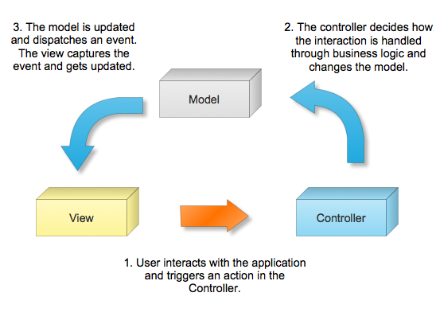
Model View Controller (MVC)
Rails uses the Model View Controller (MVC)
Design pattern which is extremely popular in server-side web applications

Slide 9
Controller
Receive events from the outside world (usually through page views)
Interacts with the model
Displays the appropriate view/layout/template to the user

Slide 10
Model
Contains data for the application (often linked to a database)
Contains state of the application (e.g. what orders a customer has)
Contains all business logic

Slide 11
View
Generates the user interface which presents data to the user
Does not do any processing
Views work is done once the data is displayed to the user.
Many views can access the same model for different reasons

Slide 12
That’s It!
Lets start programming!

